Slide 1

SCUPA
Super Cool Underwater Positioning Apparatus
Final presentation
Minor Embedded Systems
1
Notes:
Mr. Stokkink

Slide 2

Agenda
Recap
Mechanical
Hardware
Software
Conclusion
Q&A
2
Notes:
Demo

Slide 3
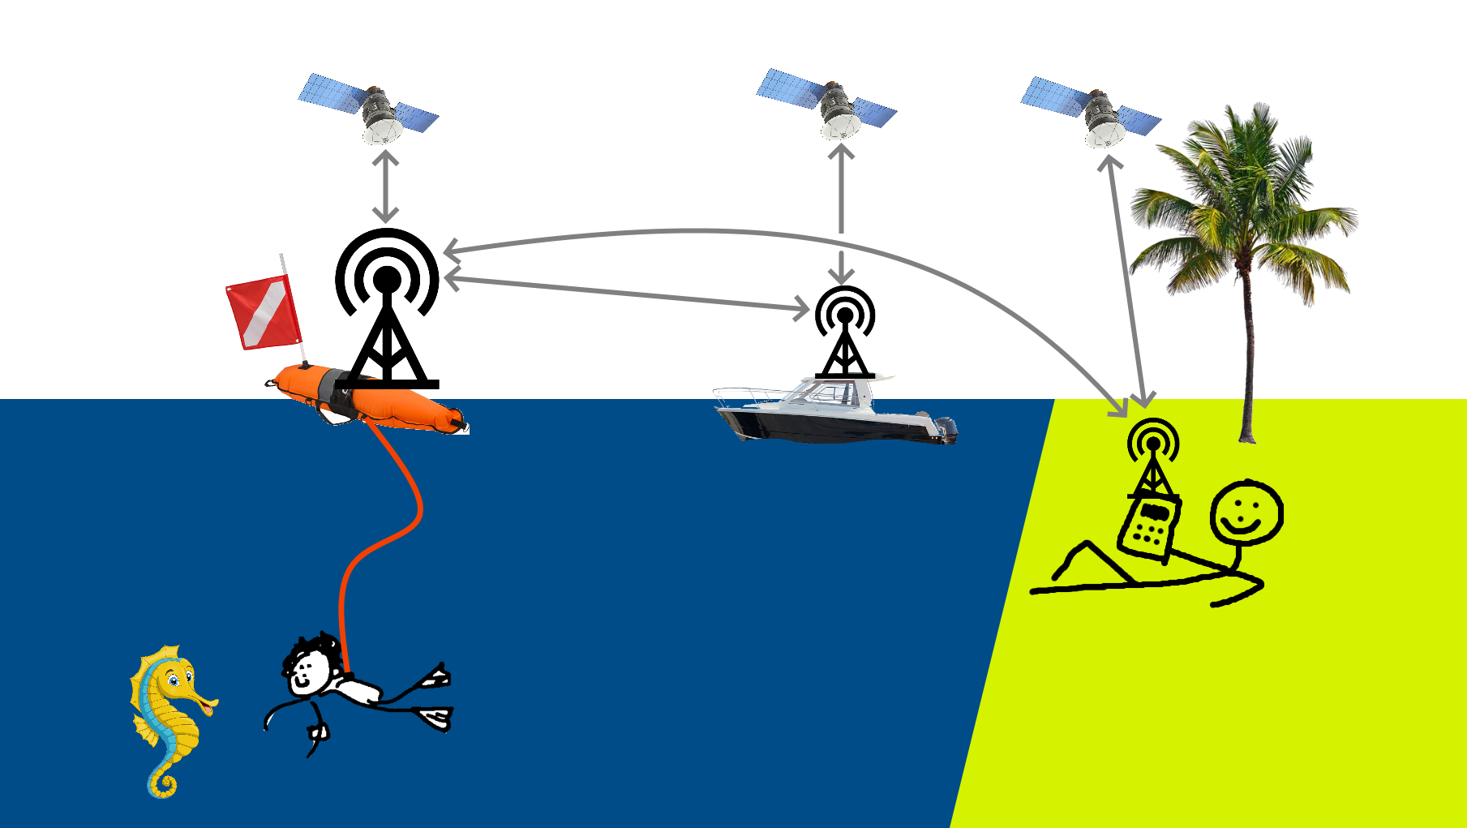
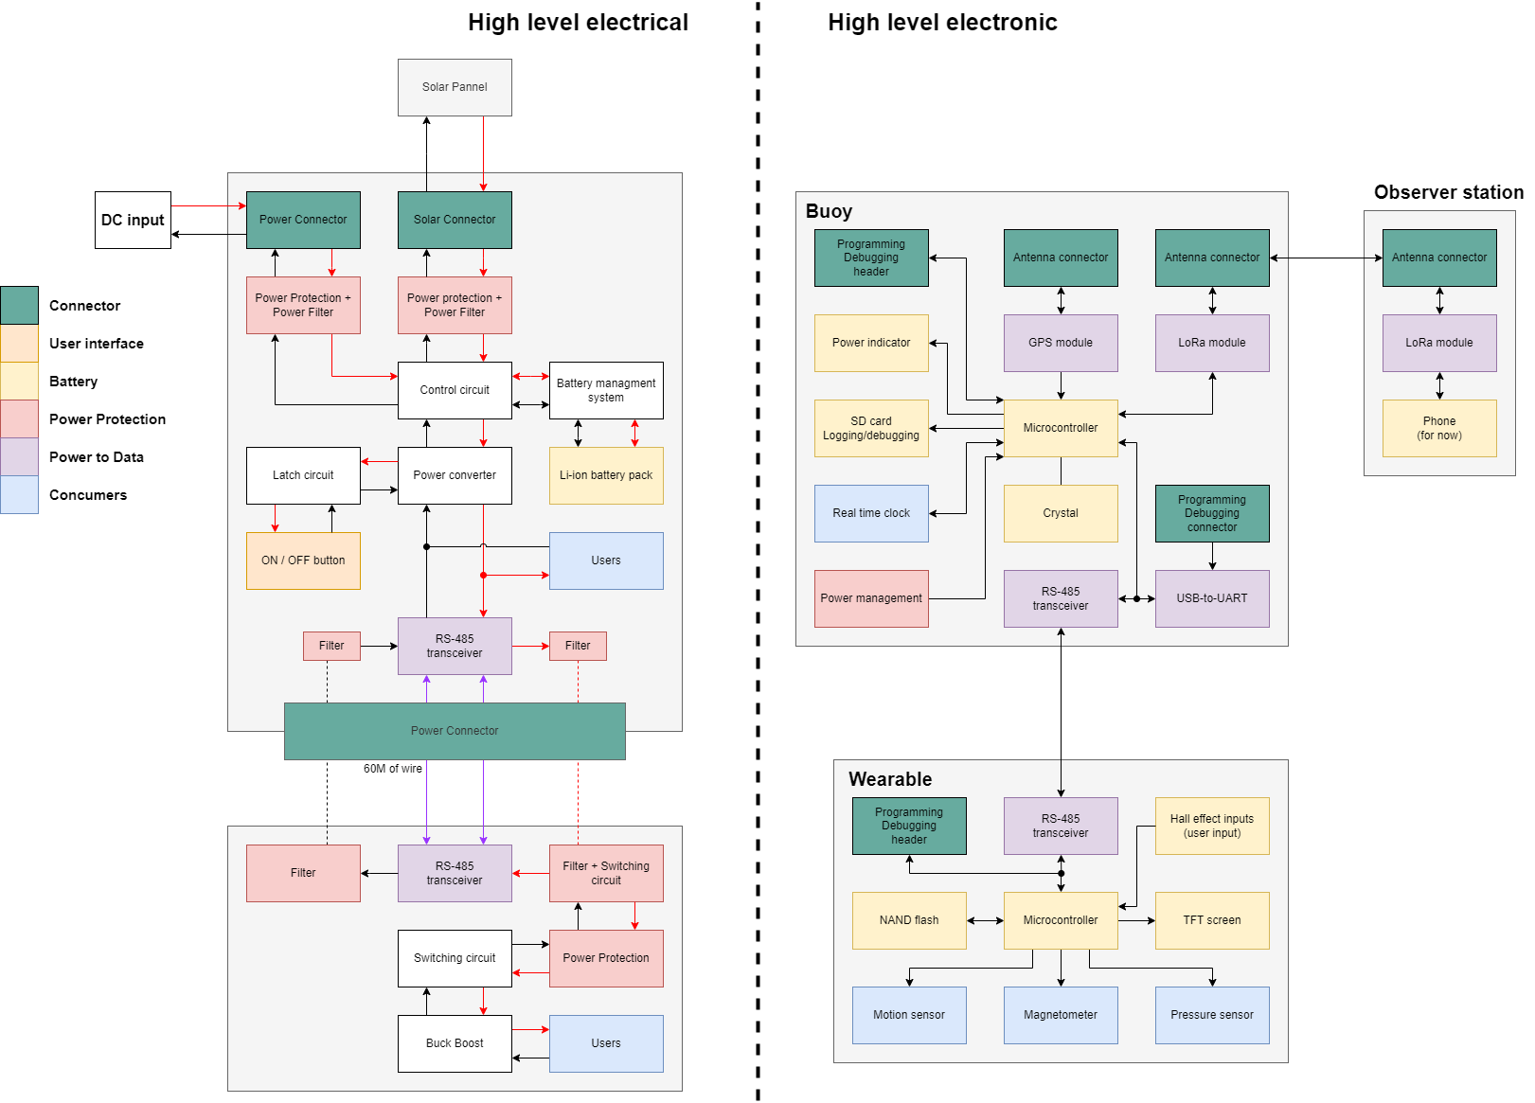
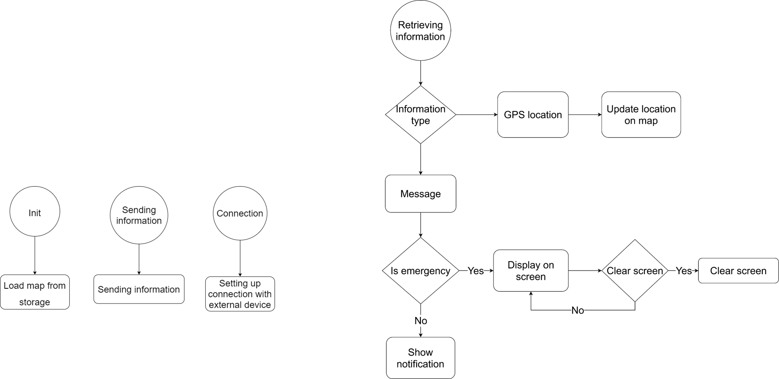
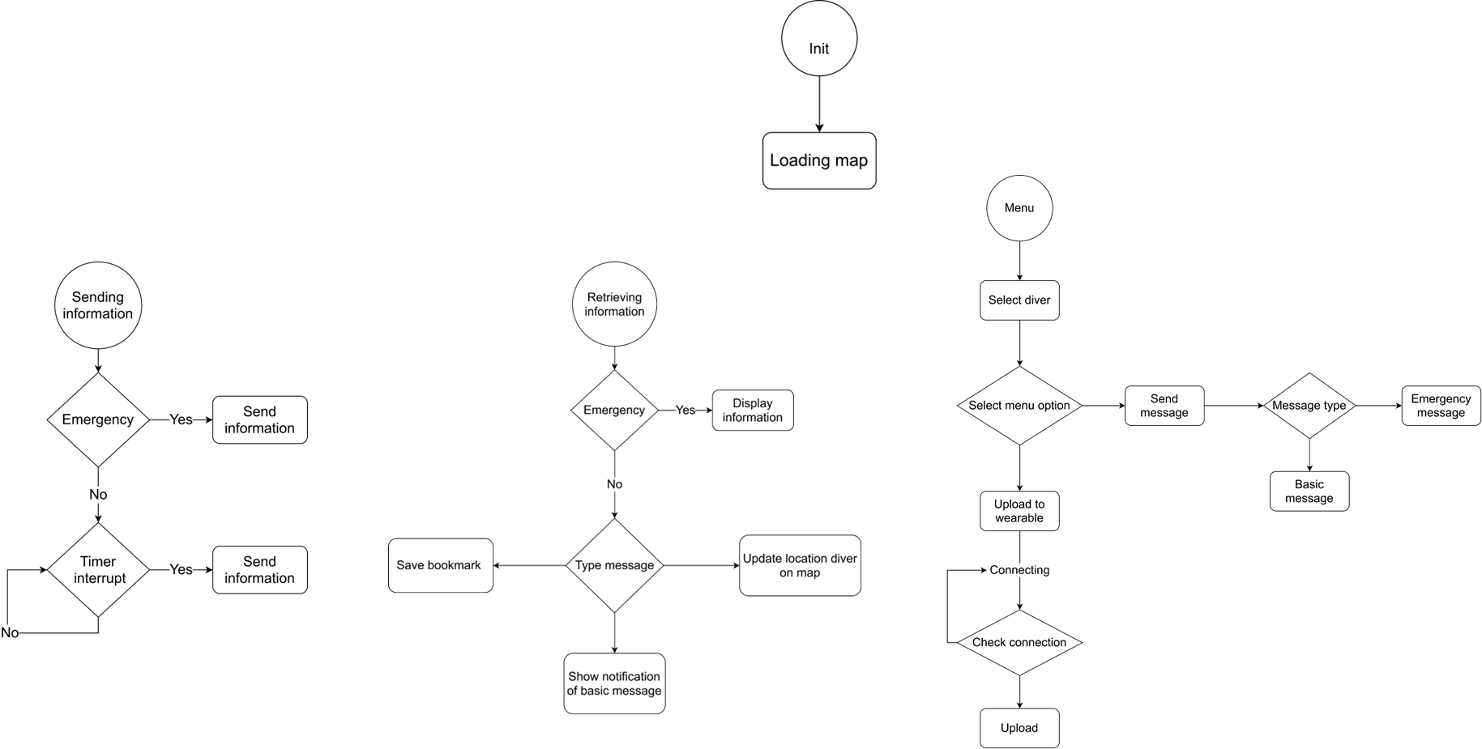
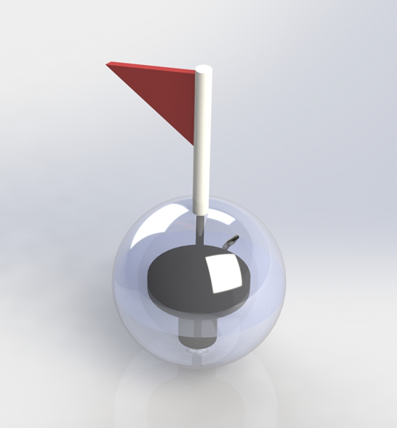
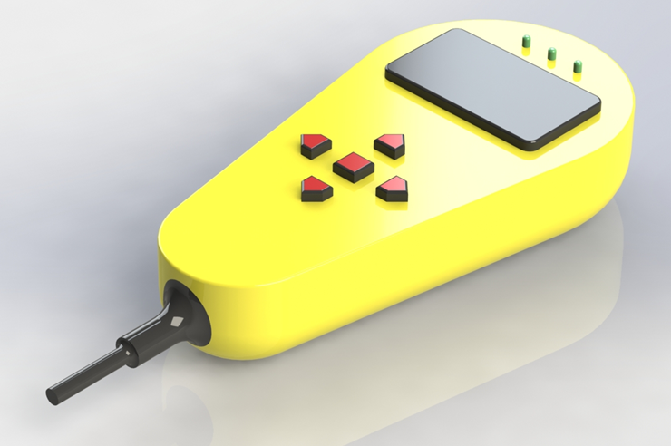
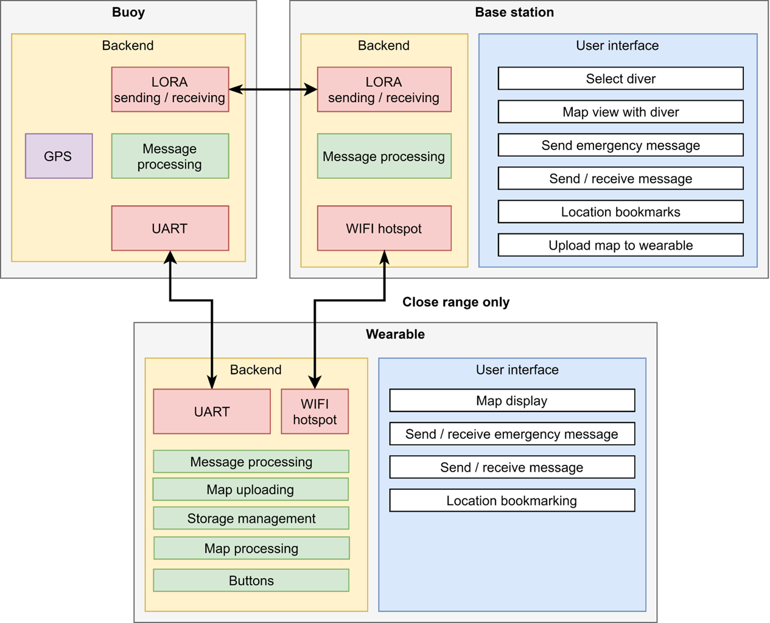
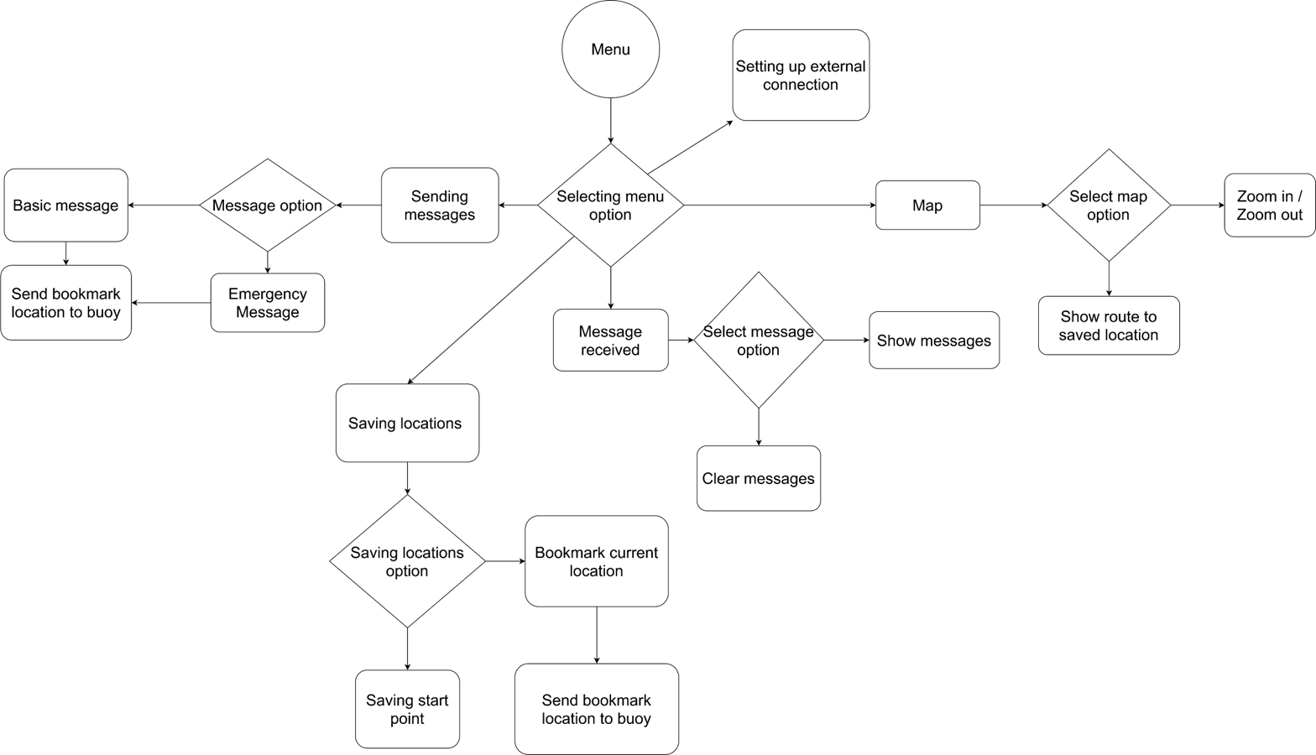
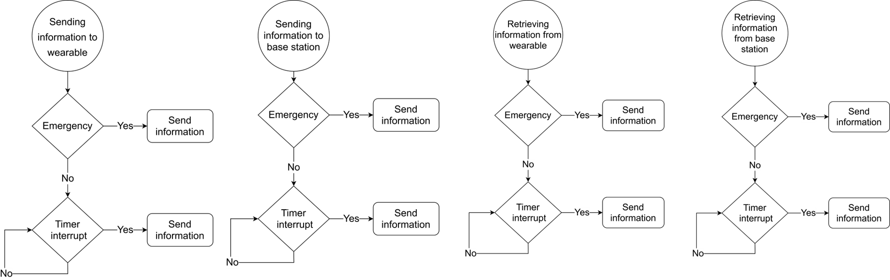
3
Notes:
First a quick recap to remind everyone of the goal of our assignment. Our client Mr. Stokkink likes to dive, a lot. But apparently, he tends to get lost as he gave us the assignment to build an underwater navigation device or system.
The main goals of this system would be to allow the diver to see his current position, store and navigate to waypoints, and allow for external observers to see his live location.
We showed the progress we made for the mechanical, hardware and software design. We had sketches, high level diagrams and flowcharts. We have since designed and realized these high-level designs, and in this presentation, we’ll be walking through what we did.

Slide 4
Mechanical
Buoy
Wearable
Cable management system
24
4

Slide 5
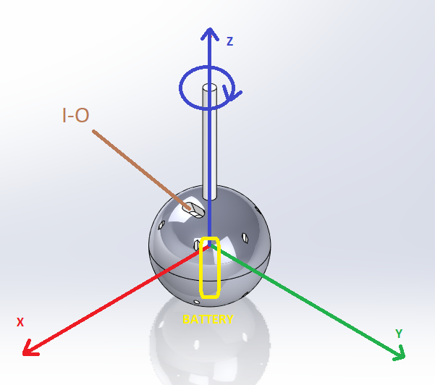
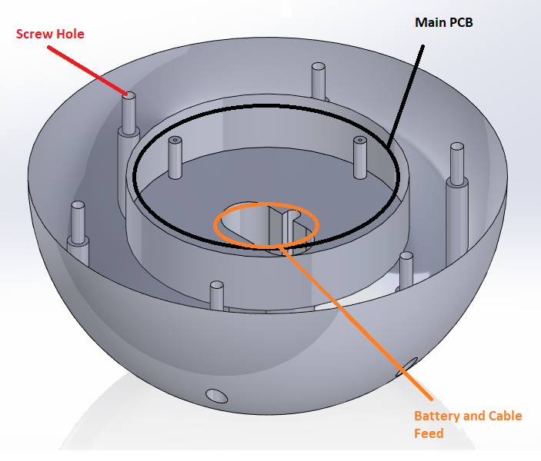

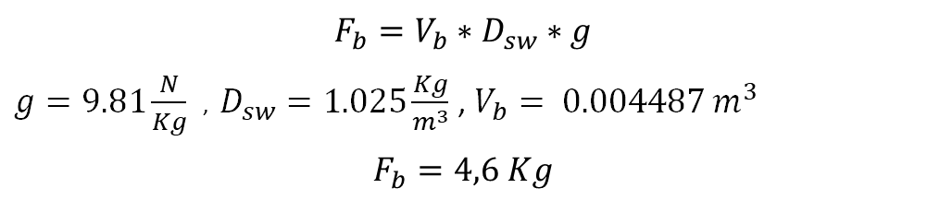
Buoy
Overall layout
Battery placement
Watertight and to be reopened
Floating
Quick access (IO)
$$F_{b}=V_{b}∗D_{sw}∗g$$
$g=9.81\frac{N}{Kg}$ , $D_{sw}=1.025\frac{Kg}{m^{3}}$ , $V_{b}= 0.004487 m^{3}$
$$F_{b}=4,6 Kg$$
5

Slide 6
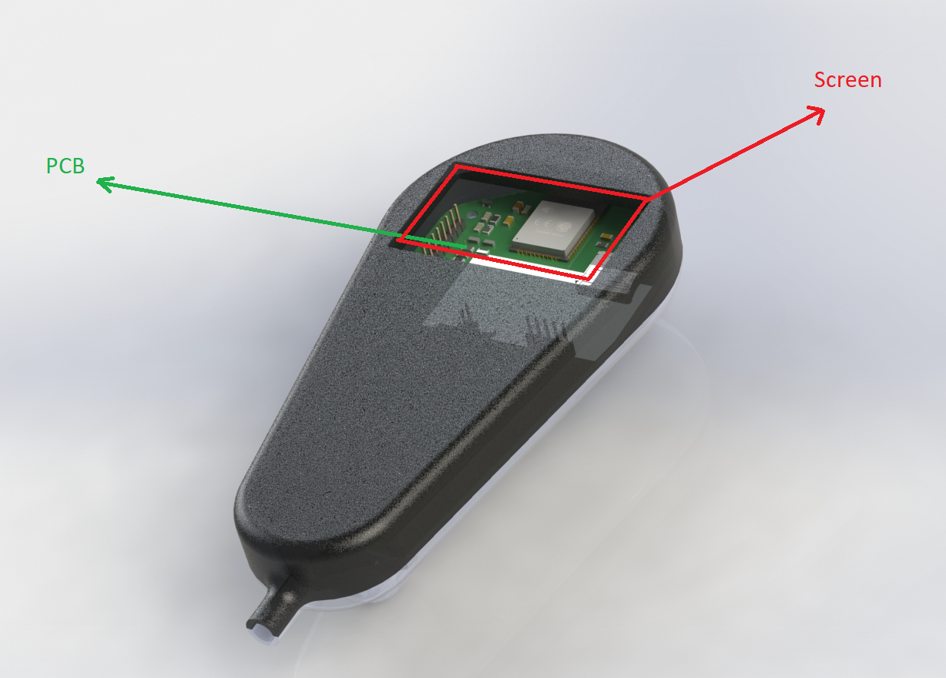
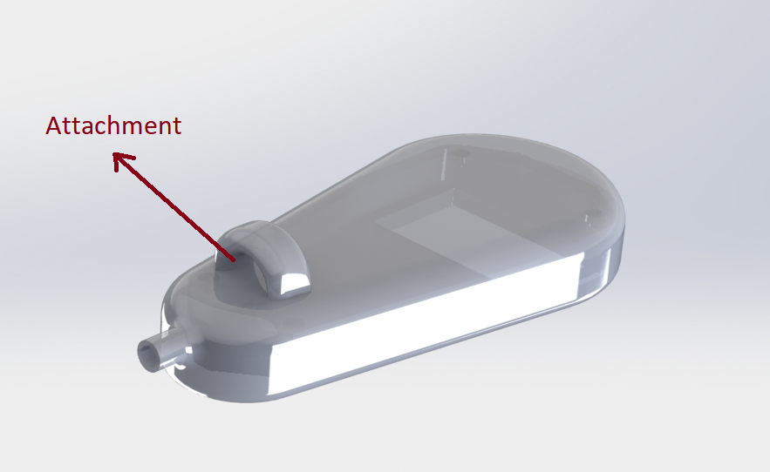
Wearable
Overall layout
Robust
Waterproof
6

Slide 7
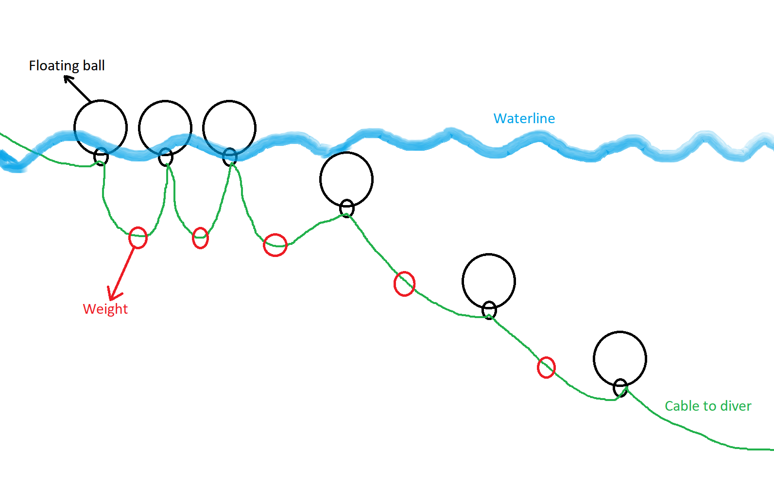

Cable Management System
Accuracy of the system
Floating balls
Principle
7

Slide 8
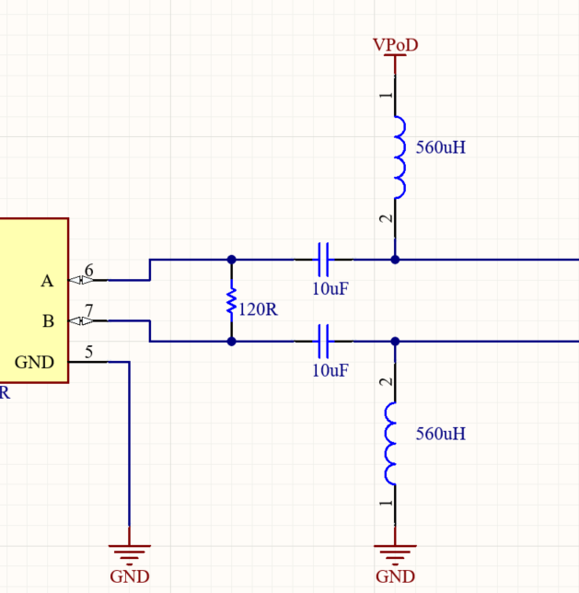
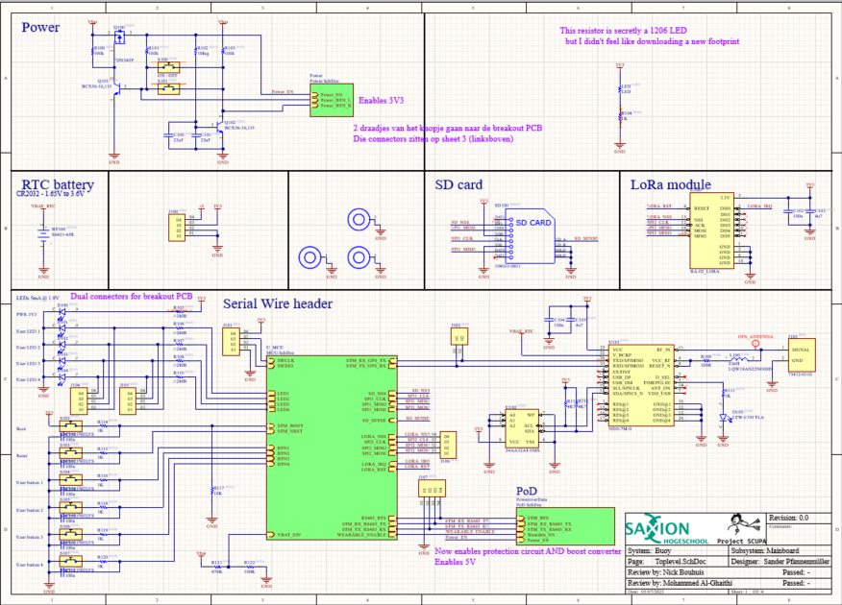
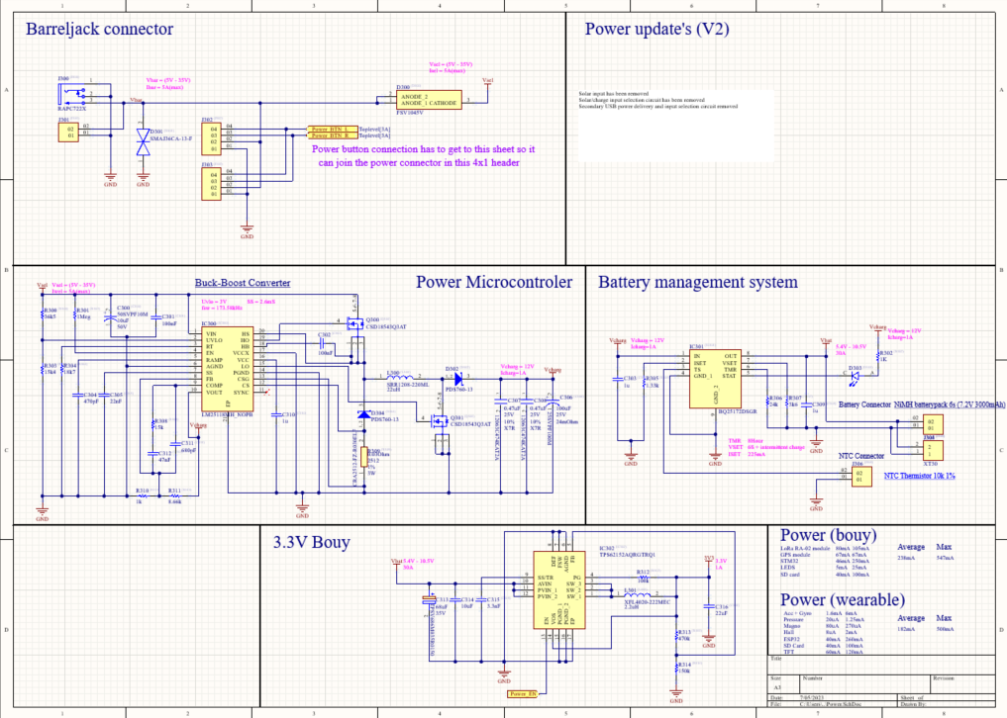
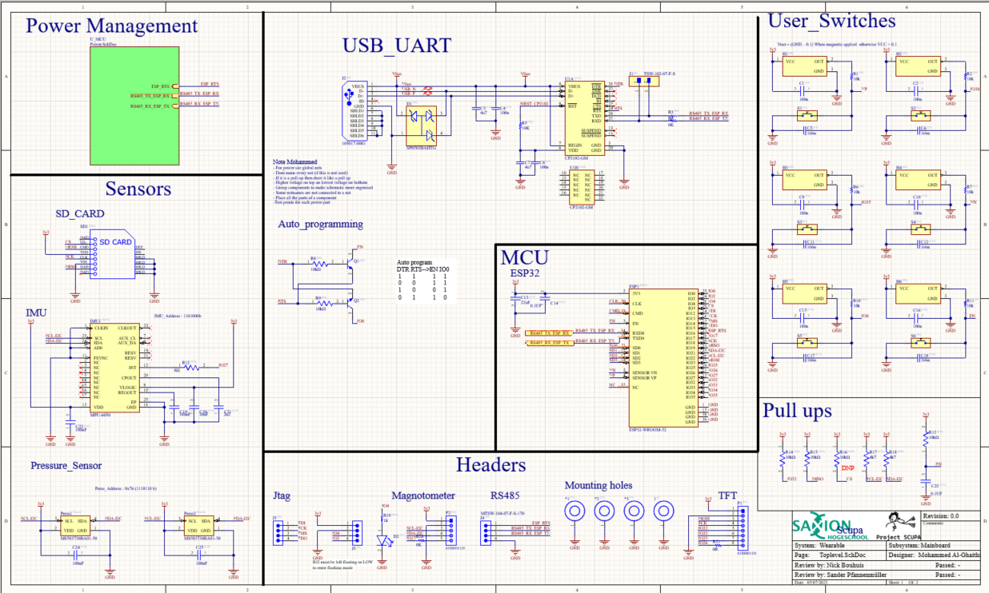
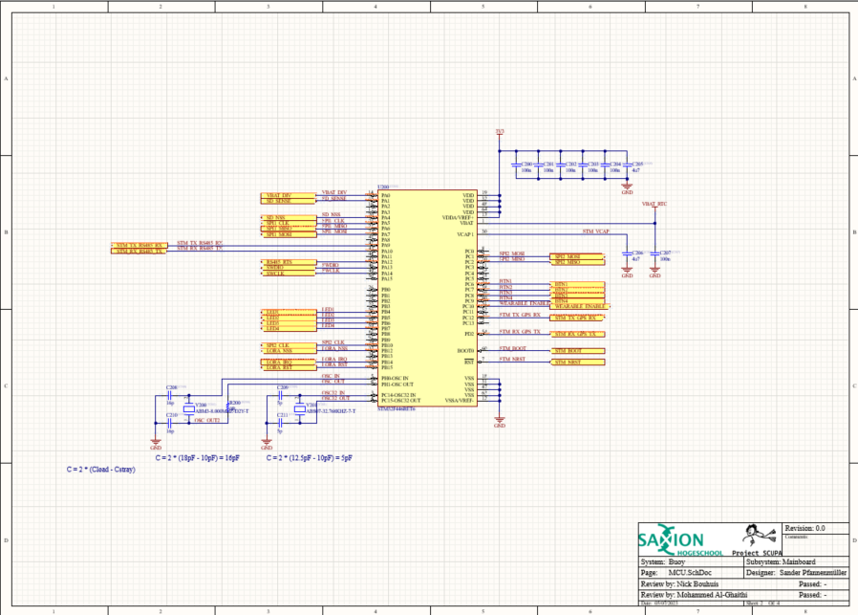
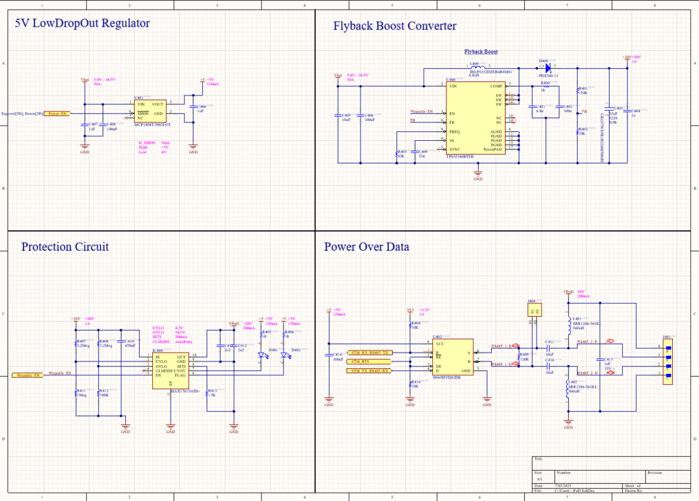
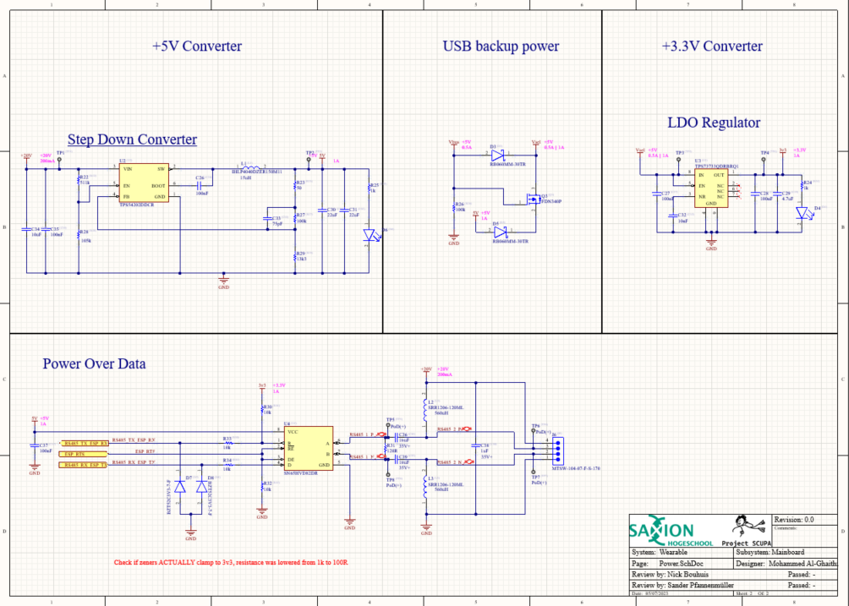
Hardware
Schematics V2
8
Notes:
The hardware team has used this high-level design to make schematics for 2 PCBs. One PCB for the buoy, which are these 4 schematics over here, and one for the wearable, which are these 2 schematics over here. I can’t go in depth into all of the details right now, but I do quickly want to explain the Power over Data part. In order to reduce the weight and thickness of the cable that has to go down to the diver, we have used 2 inductors for both power and data. This right here is a differential pair that is connected to the RS485 transceiver. These 2 cables are the cable that connects the buoy and wearable.
When data is being sent, the vertical edges in the signal are high frequency, and pass through the DC-blocking capacitors. This superimposes the data on these lines. At the same time, the power flows through the inductors onto the line. The inductors keep the superimposed noise from reaching the power supply of either PCB. Later I’ll show some oscilloscope images of this signal.

Slide 9
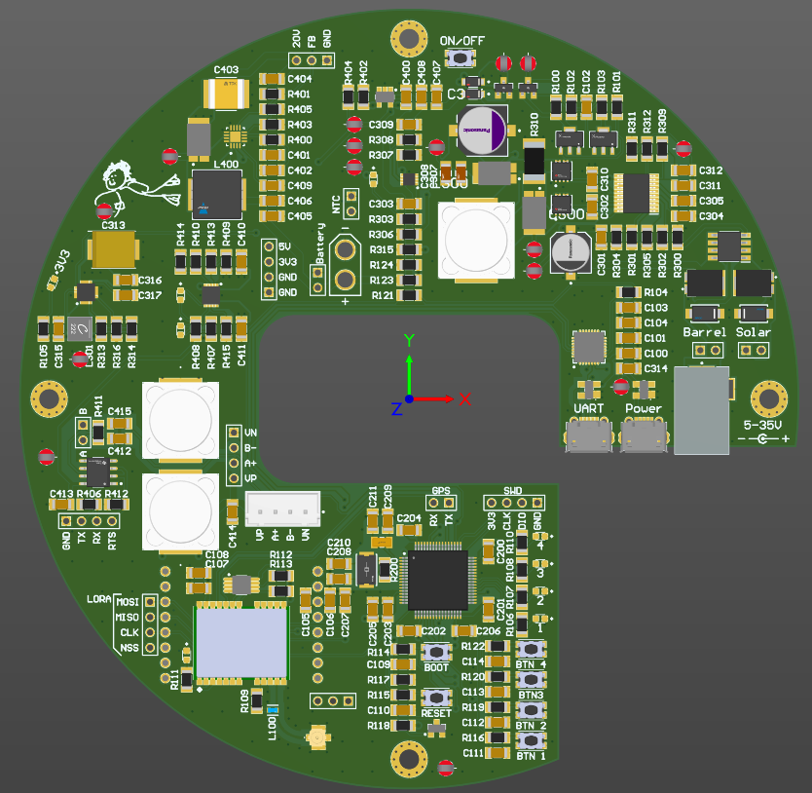
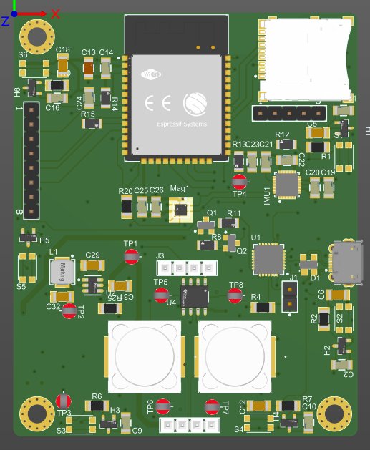
Hardware
Version 1
9
Notes:
We’ve made 2 versions of both PCBs. (4 layer) Version one of both mostly worked, but we did find some minor issues in both. Also the formfactor had to change for the final version, so we made a second iteration.

Slide 10
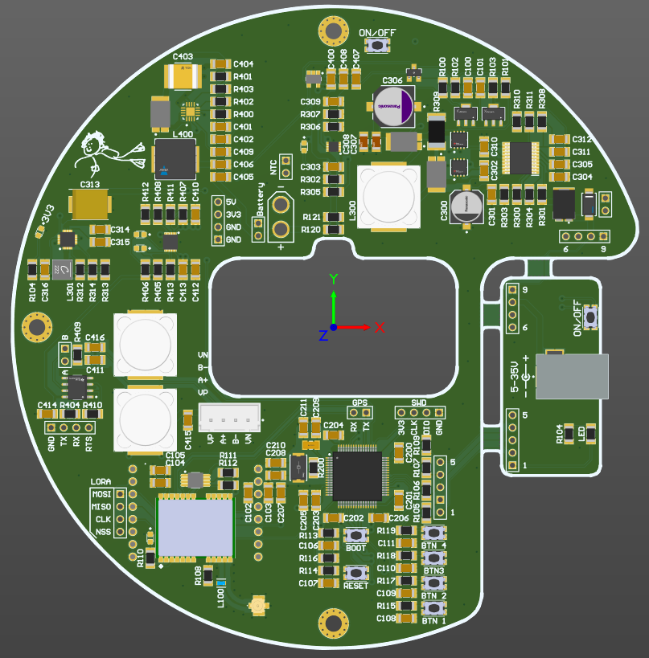
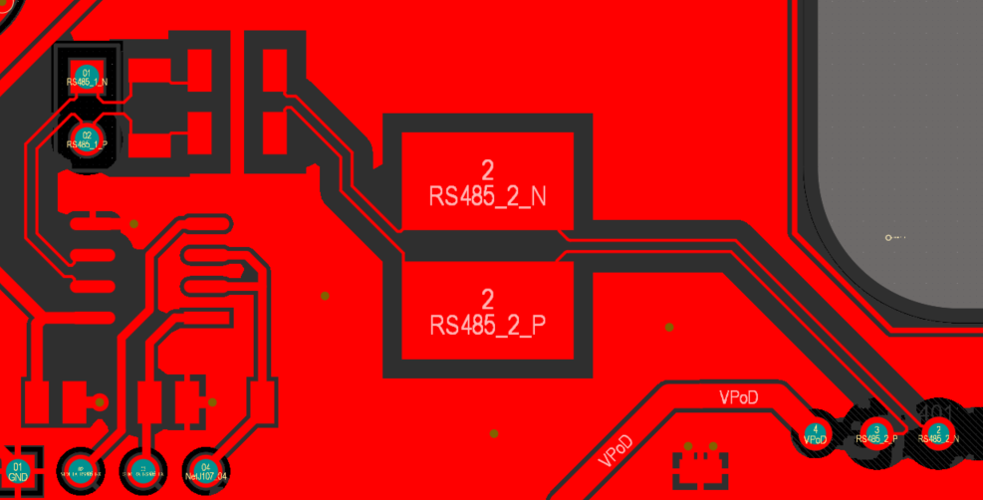
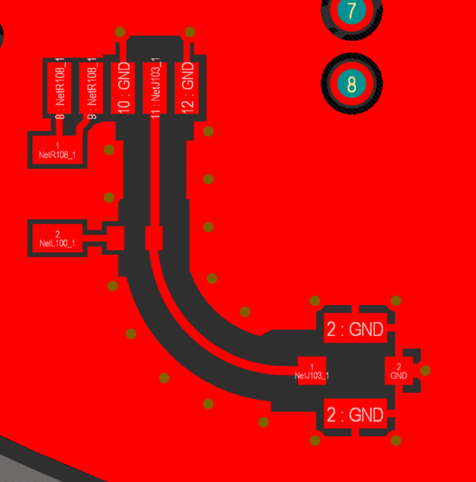
Hardware
Version 2
10
Notes:
This is version 2 of the buoy PCB. The main change to this PCB is the addition of this little PCB. This is a breakout PCB that can be broken off, and mounted on the outside of the enclosure. This PCB exposes the charging port, power LEDs and power button to the user. This PCB is connected to the main PCB with wires.

Slide 11
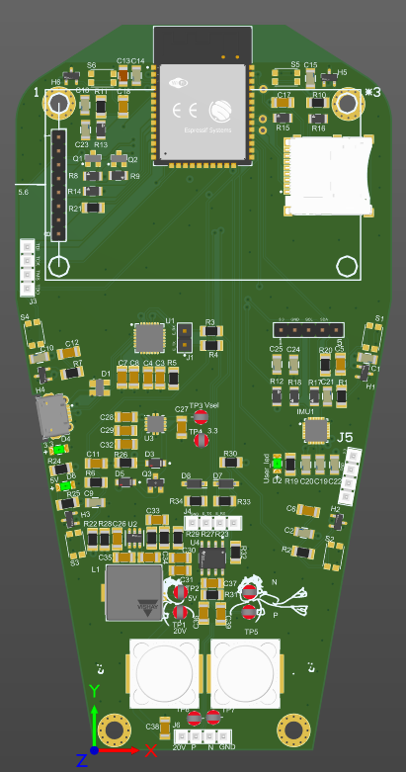
Hardware
Version 2
11

Slide 12
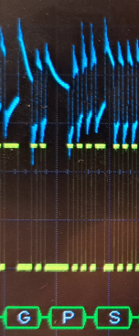
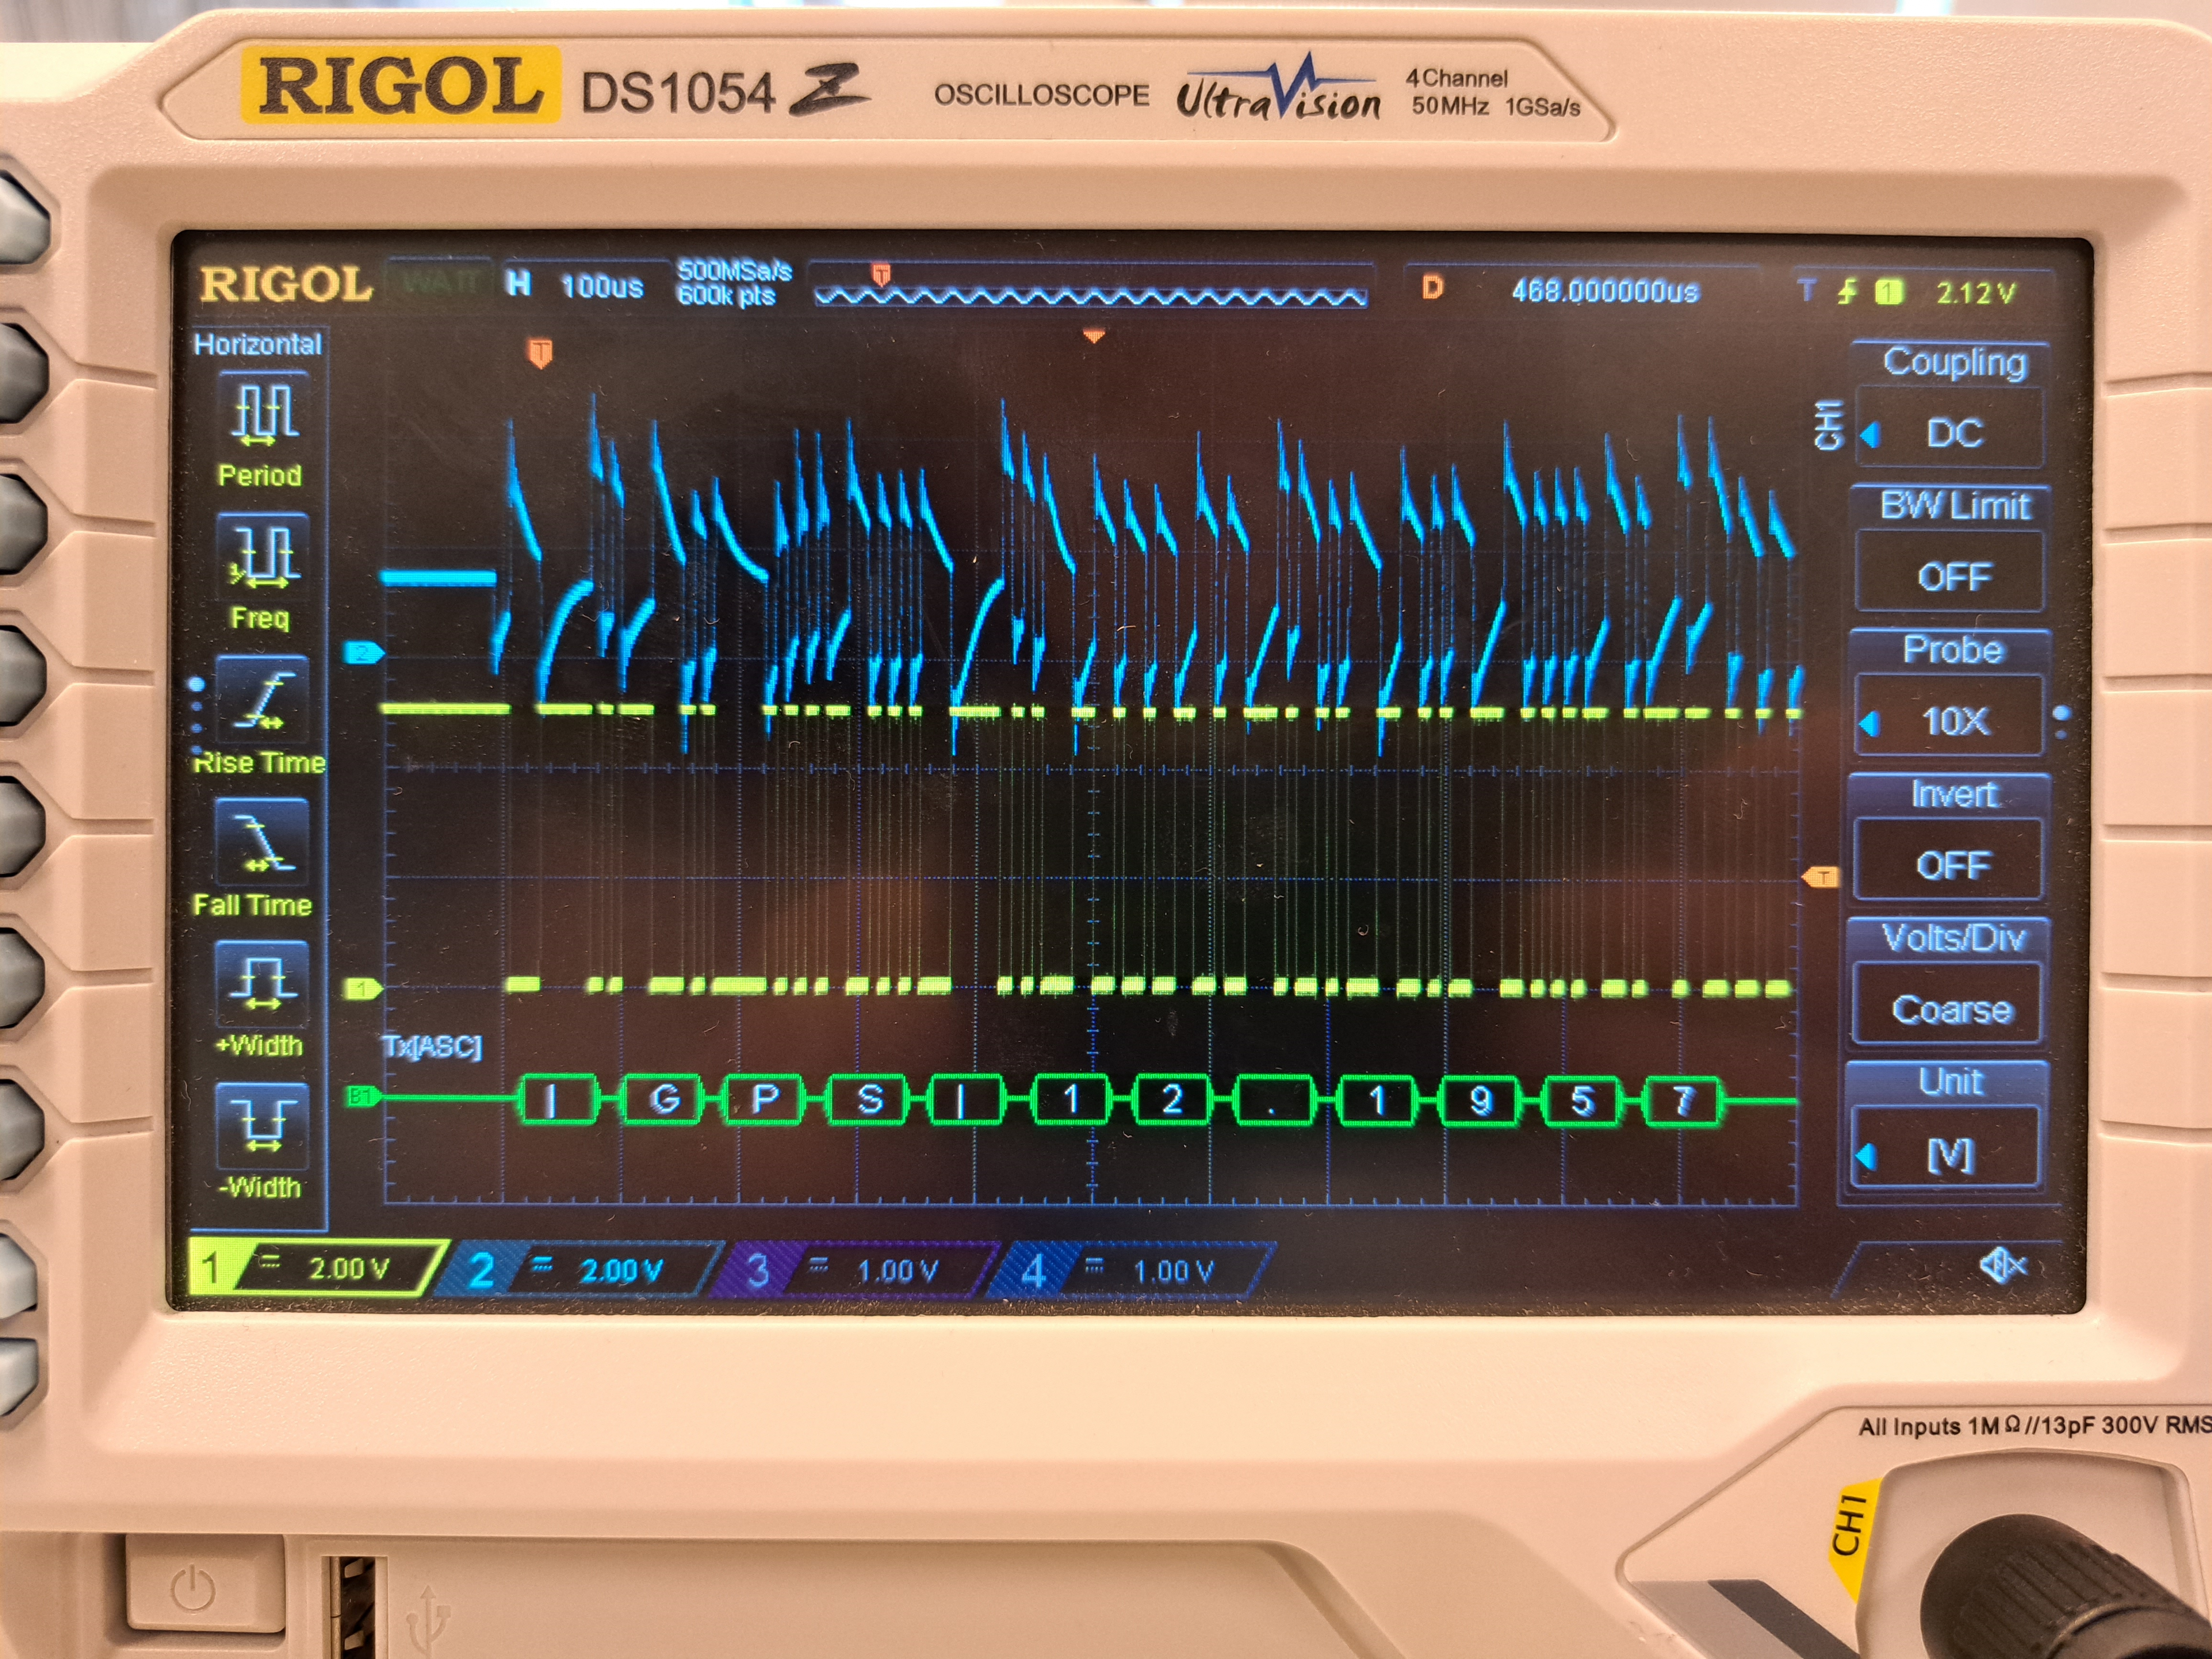
Hardware
PoD signal
12

Slide 13
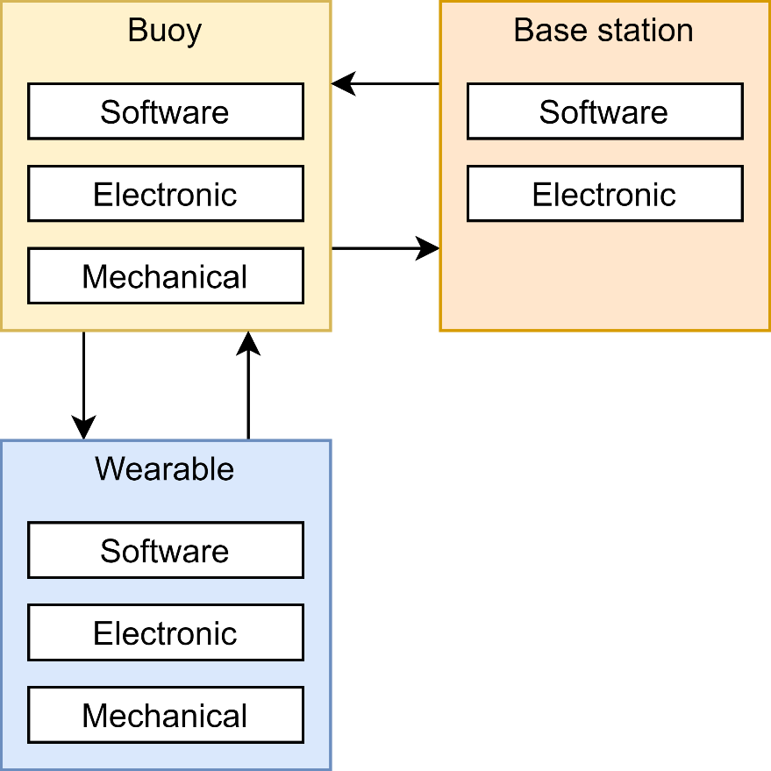
Software – overview
Base station
Interface with map and diver location
(Emergency) message functions
Works offline
Buoy
Relaying of messages
GPS location
Wearable
Interface with map and user location
Bookmarking of locations, guiding to bookmarks
(Emergency) message functions
13
Notes:
Just like the hardware part, each subsystem requires software, and each of these subsystems has its own requirements for the software

Slide 14
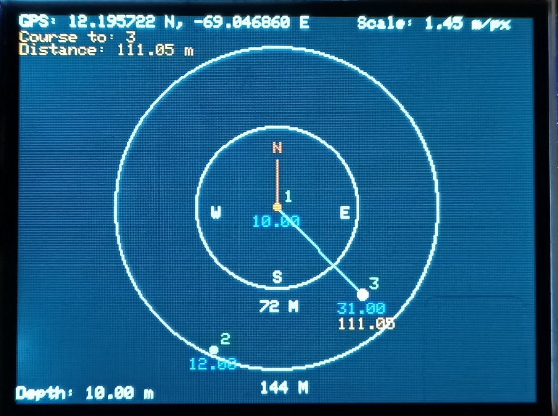
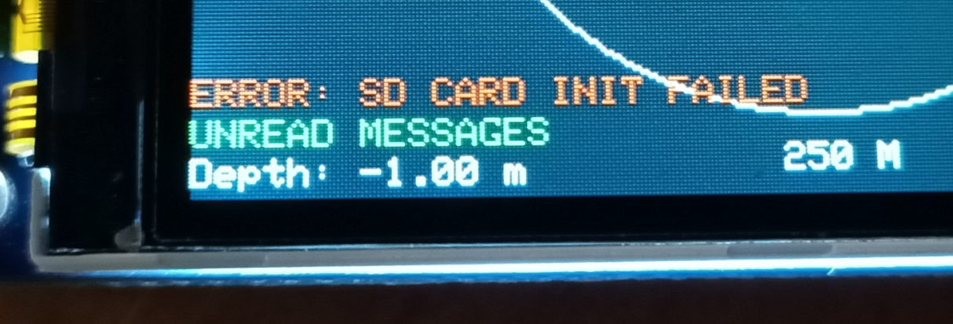
Software wearable
Zoom level
Compass needle
Range rings
Overview
Sensors: depth, compass, GPS (on buoy)
SD card for saving GPS locations and other data
Nested state machine for the menu system
Graphics are drawn using these state machines
Map
Displays saved bookmarks
Zooming
Compass in the center
Show course line to a selected bookmark
Extra info:
Unread message reminder, SD card initialization status
Course line
Bookmark ID
depth
Distance
User depth
14

Slide 15
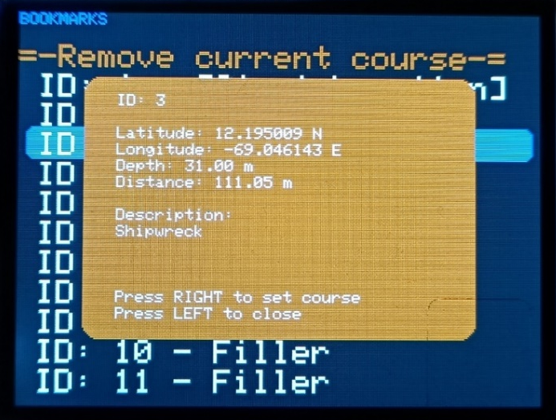
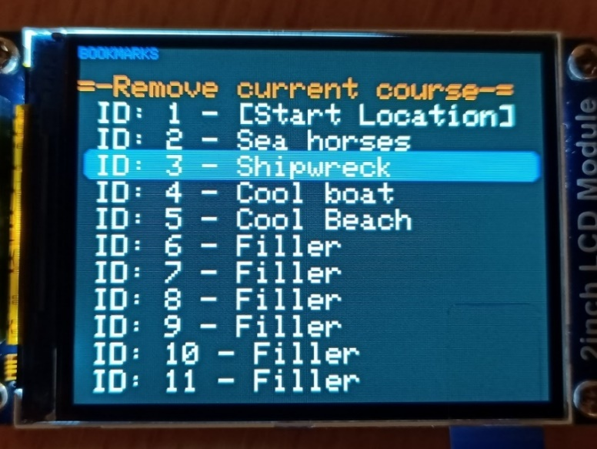
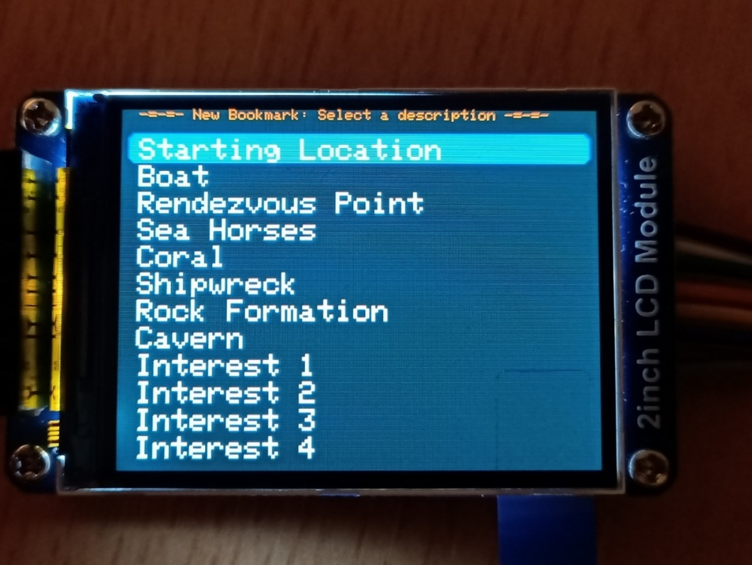
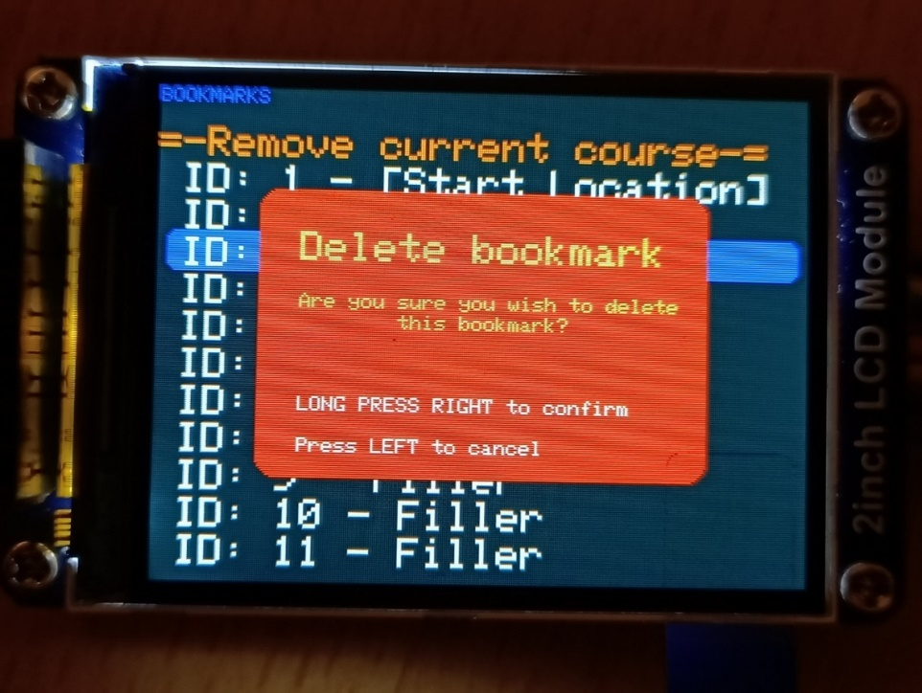
Software wearable
Backend GPS system
Flat earth approximation for GPS locations
Increases calculation speed
All calculations done relative to user location
Converted and scaled to screen coordinates
Bookmarks
Synchronized with SD card
Set course to a bookmark
Save current location as bookmark
Opens menu with descriptions for that location
Descriptions customizable on SD card
Show info popup for more information
Deleting bookmarks
Bookmark menu
Info popup
Selecting description for a new bookmark
Deleting a bookmark
15

Slide 16
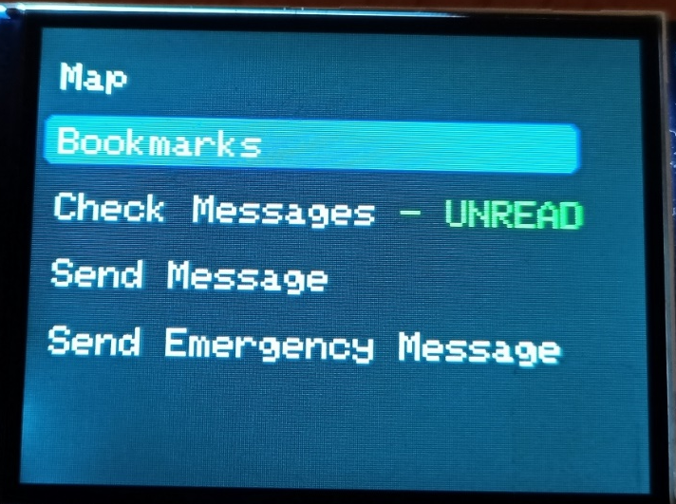
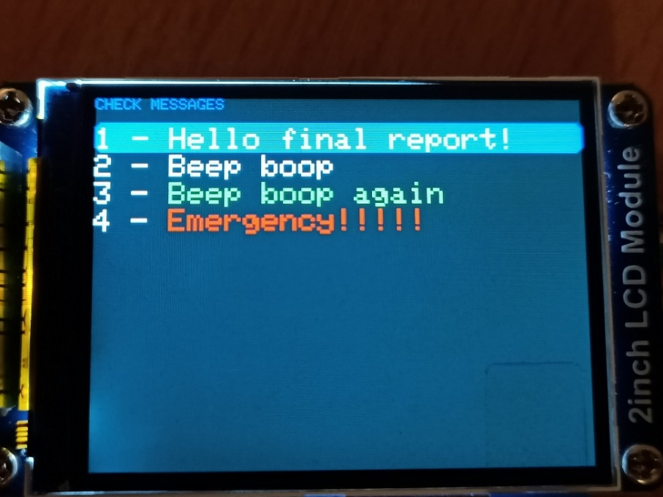
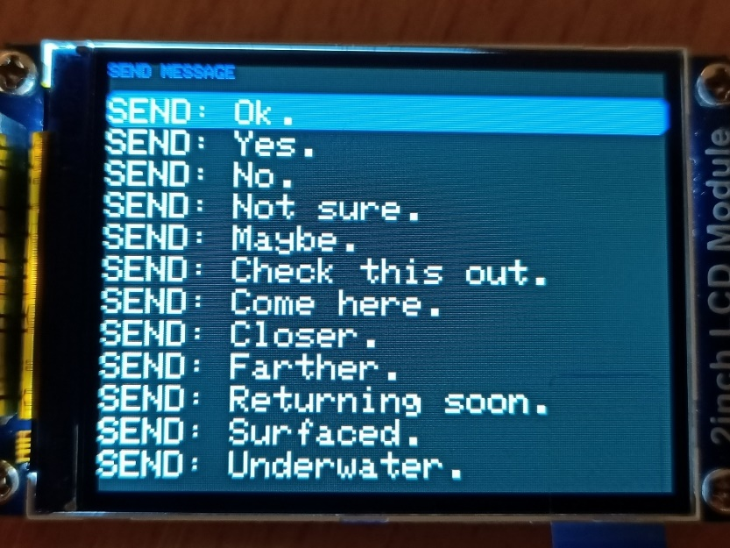
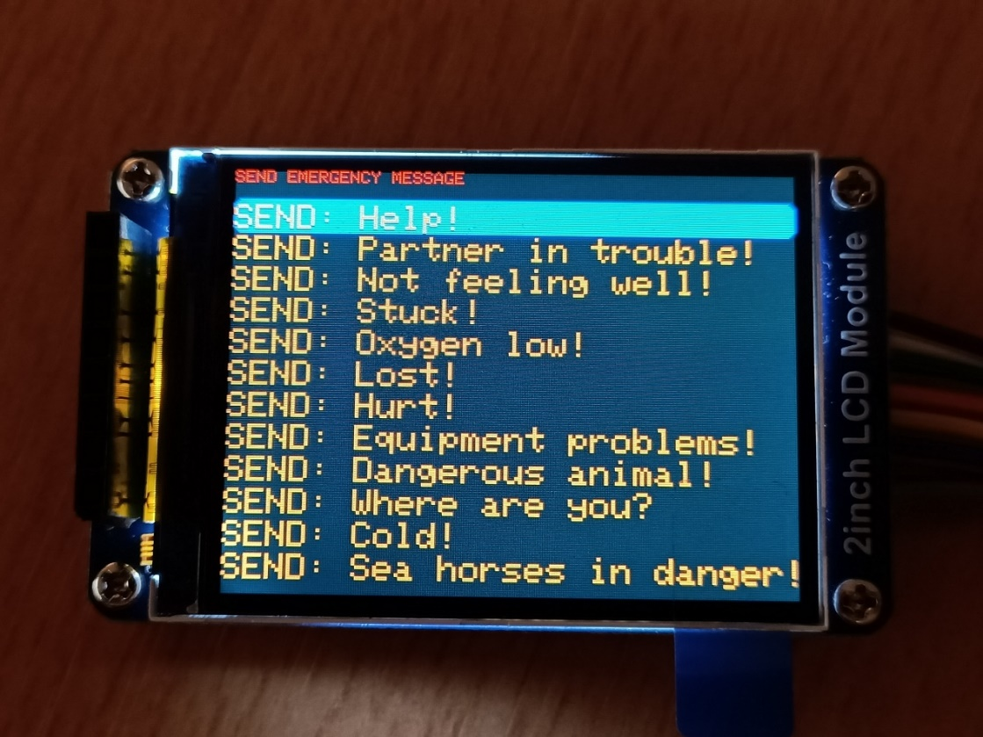
Software wearable
Messages
Menu to check received messages
Unread message notifications in the main menu and on the map screen
Emergency messages pop up on screen when received
Ability to send preprogrammed regular and emergency messages
These can be customized on the SD card
Main menu UNREAD notification
Message list
Sending regular message
Sending emergency
16

Slide 17
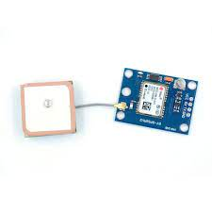
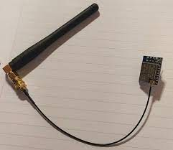
Software buoy
Provide GPS information to wearable
Send/receive data from PoD
Transmit messages over LoRa radio
Receive and filter incoming LoRa messages
Format: |<type>|<contents>|\n
GPS module with antenna
LoRa module with antenna
17

Slide 18
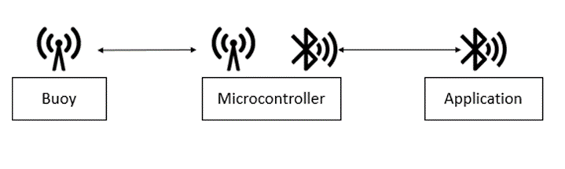
Software home station
Overview
Retrieving and sending information using LoRa and BLE
See location diver and home station
Sending and retrieving messages to the wearable through the buoy
Sending and retrieving emergency to the wearable through the buoy
Email locations from the dive
18

Slide 19
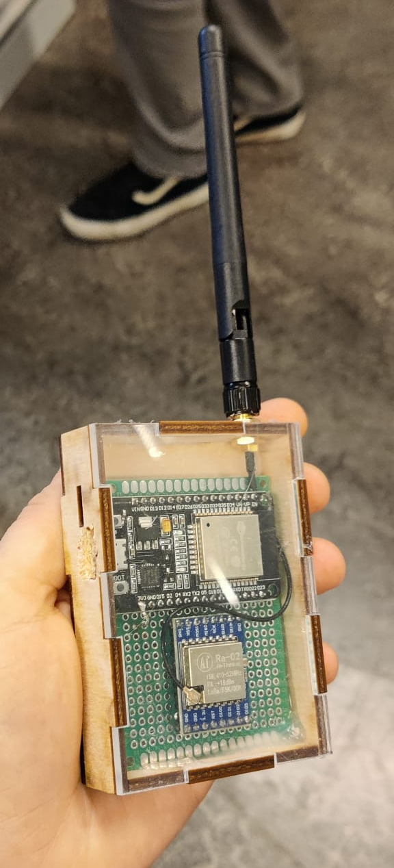
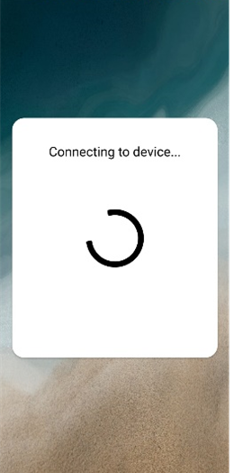
Software home station
Overview
Using BLE and LoRa to communicate with the wearable through the buoy
ESP32 as middle solution to let the application and the buoy communicate over a large distance
19

Slide 20
Software home station ESP32
Integration of BLE and LoRa providing bidirectional wireless communication
Data received via LoRa is sent over Bluetooth to connected device
Constantly reading for LoRa messages
Data received via Bluetooth is sent over by LoRa
Triggered by a callback function
20

Slide 21
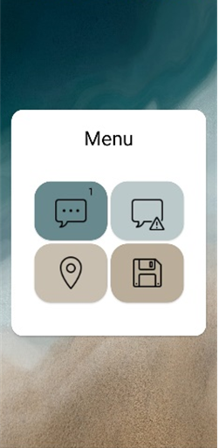
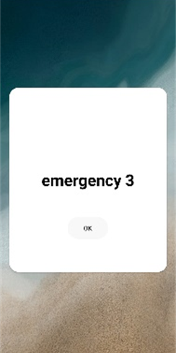
Software home station GUI
When the BLE connection is established, the application will start the message retrieving service
Functionalities of the application
Sending and retrieving normal messages from and to the wearable
Sending and retrieving emergency messages from and to the wearable
Seeing the location of the diver and the home station
Emailing the saved location data to the user
The menu also shows the amount of unread messages for normal and emergency
1
5
2
3
4
When an emergency messages is received a pop up will show up
21

Slide 22
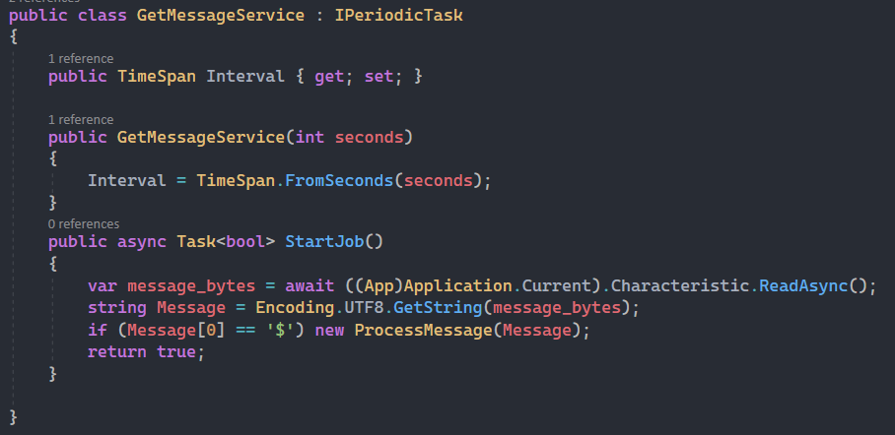
Software home station service
Matcha.Background service NuGet package
Runs the StartJob every 3 seconds
Calls the ProcessMessage class to handle the incoming messages
ProcessMessage class
Checks if it is a new message
Saves message to the database
Uses MessageCenter to publish notification to the subscribers
Saves message as previous message
22

Slide 23
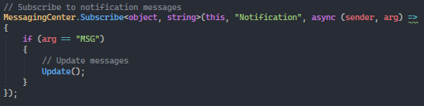
Software home station message center
Message center is used to update the pages when a new message is retrieved
When new message is published update the data
Using pubsub
23

Slide 24

Software home station chats
Retrieves the messages from the database when appearing
Updates the messages retrieved using the message center
When a message is sent the message is saved to the database and send over to the ESP32 using BLE
24

Slide 25

Software home station map
Uses the Xamarin.Forms.Map NuGet packet and Google map API
Shows the location of the base station and the diver
Updates the location when new coordinates are retrieved
25

Slide 26

Software home station email data
Retrieves all the location data from the database
User can choose a subject and recipient otherwise default
Will send all the data from the database via email to the user
26

Slide 27

Conclusion
It works!
Not completely finished
27

Slide 28


Q&A
28

Slide 29

Extra

